Slide 1

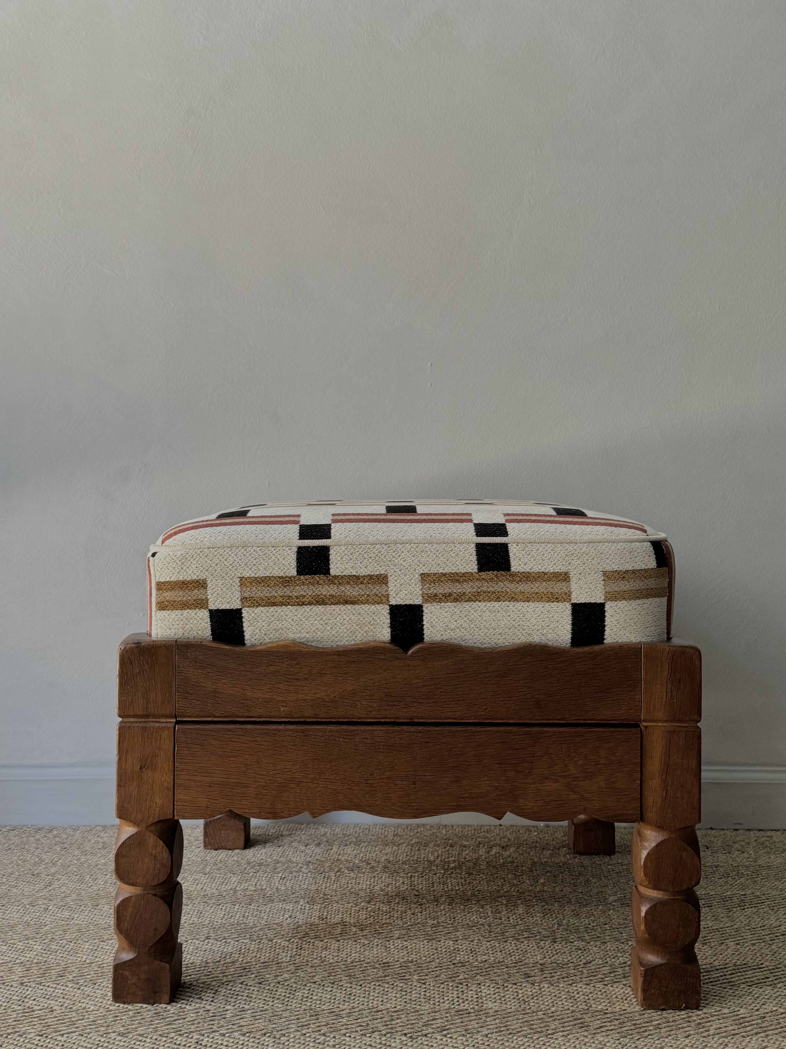

Small Danish Ottoman
Description
Small Danish Ottoman.
Dimensions
H: 17.5, W: 21.25, D: 21.25 inches
Era/Origin
Denmark
Materials
Dark Oak, Upholstery

