Slide 1

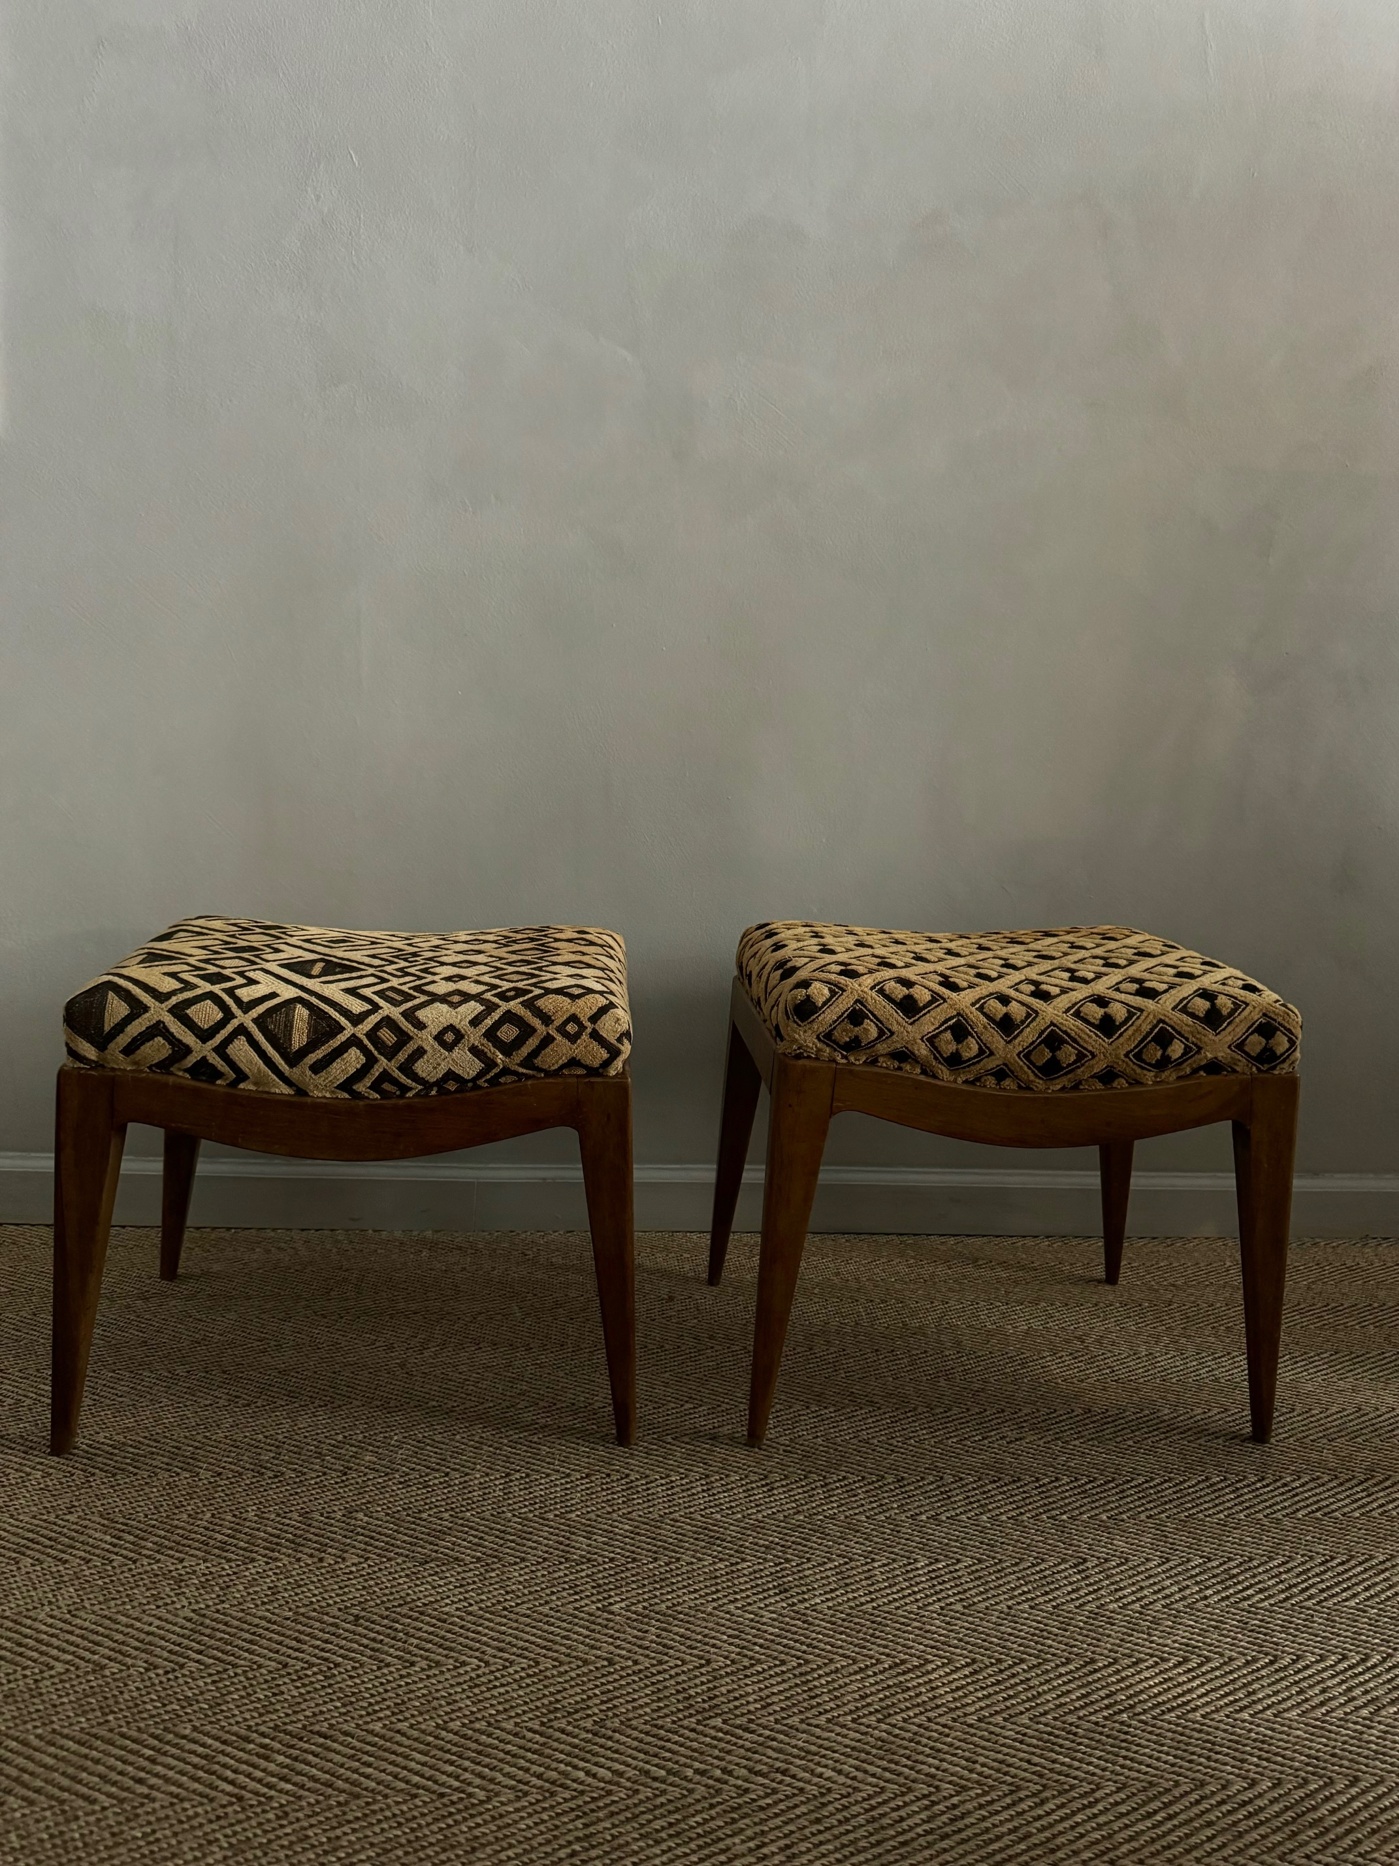

Pair of Beech Stools in Raffia Kuba Cloths
Description
Pair of beech stools upholstered in raffia Kuba cloth
Dimensions
H: 17, W: 18.5, D: 14.5 inches
Era/Origin
France, mid 20th Century
Materials
Beech wood, Kuba cloth

