Slide 1
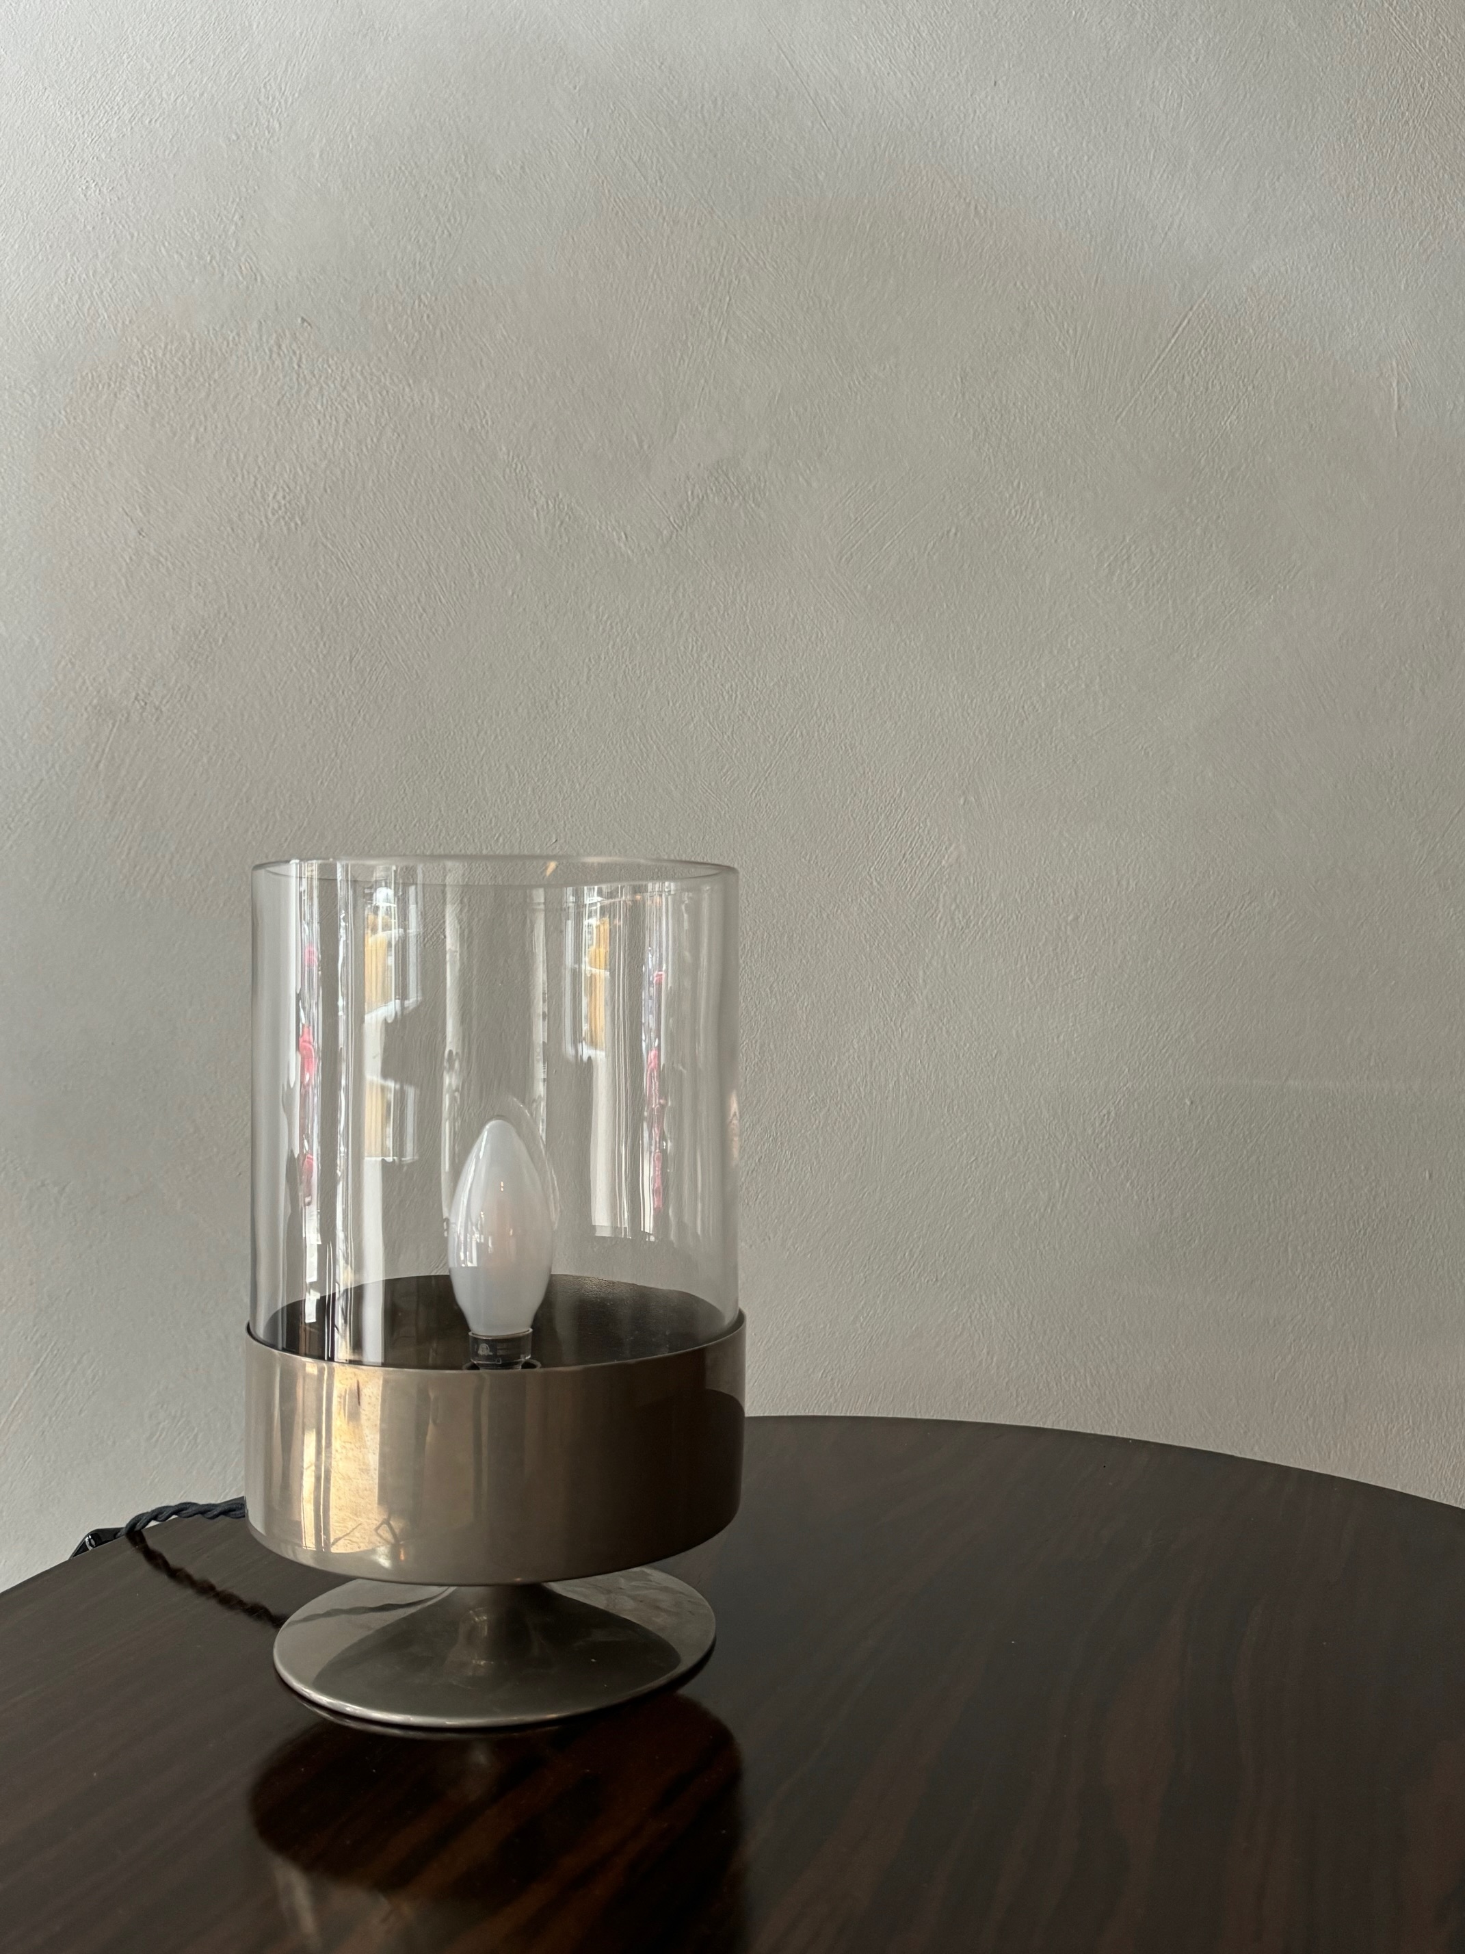
Pair of Philippe Barbier Table Lamps. Signed.
Description
Rare pair of Philippe Barbier nickel plated brass and glass table lamps
Dimensions
H: 11.81, D: 6.3 inches
Era/Origin
France, c. 1970’s
Materials
Nickel plated brass, glass

