Slide 1
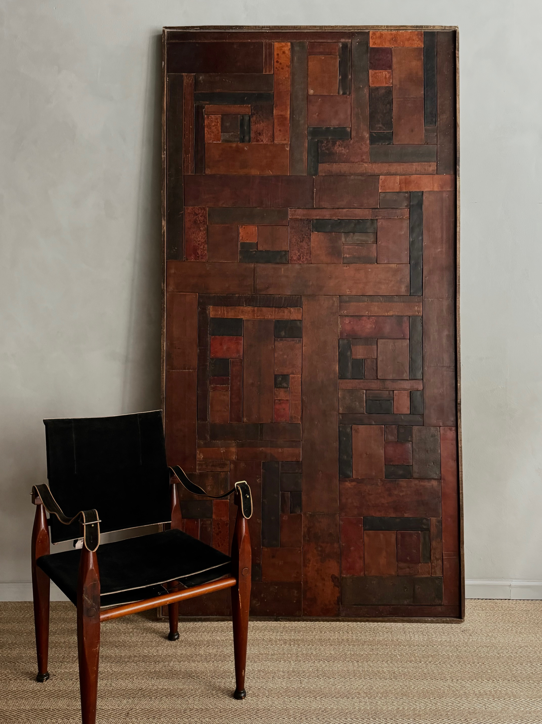
Enormous Patchwork Leather Panel
Description
Enormous Patchwork Leather Panel enclosed in an oak frame, France, C. 1970’s
Dimensions
H: 98 ½, W: 51 ¼ inches
Era/Origin
France, 1970’s
Materials
Leather, Oak

